Slide 1
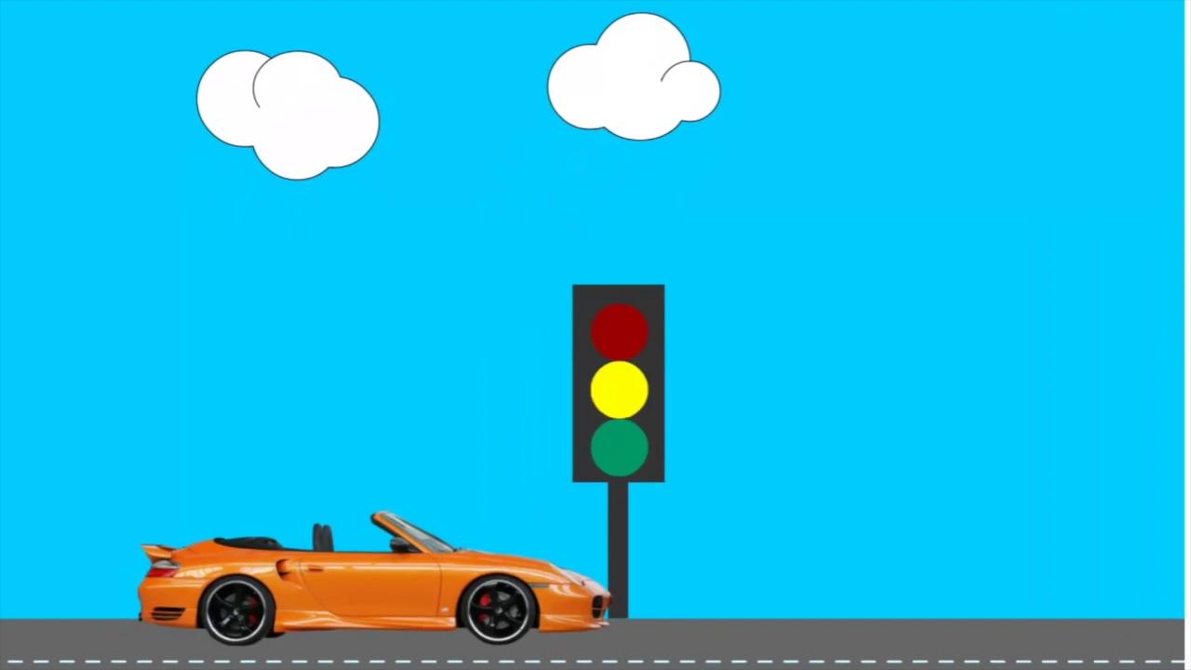

Slide 2

Detecting Traffic light

Slide 3
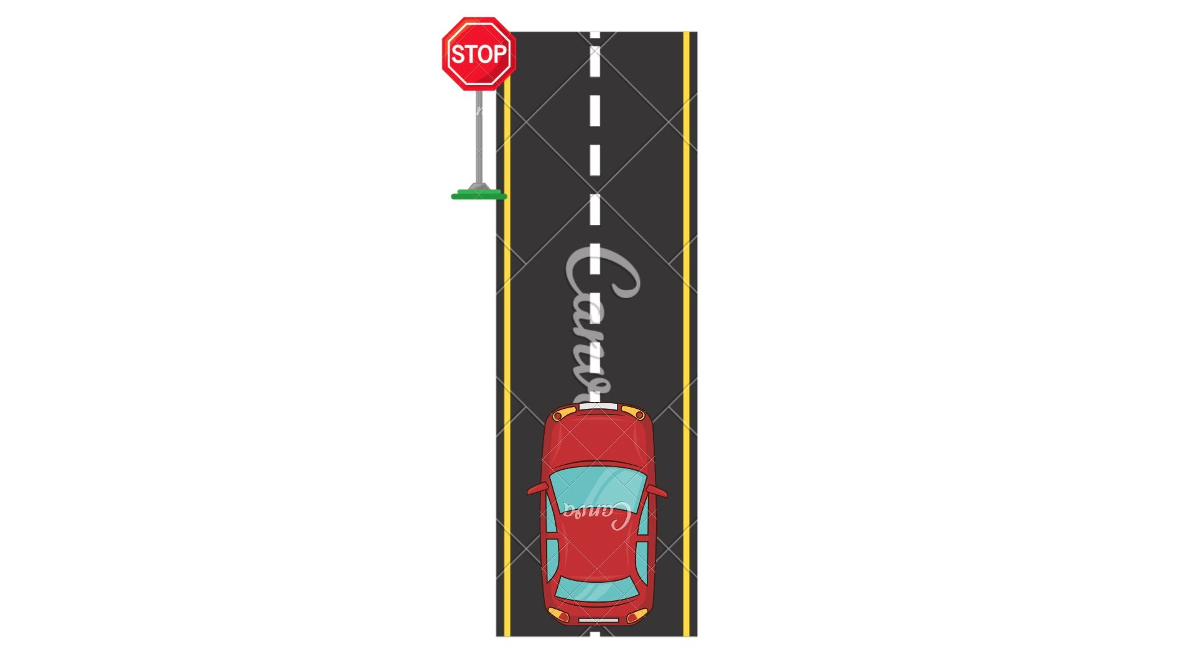
Stop Sign

Slide 4
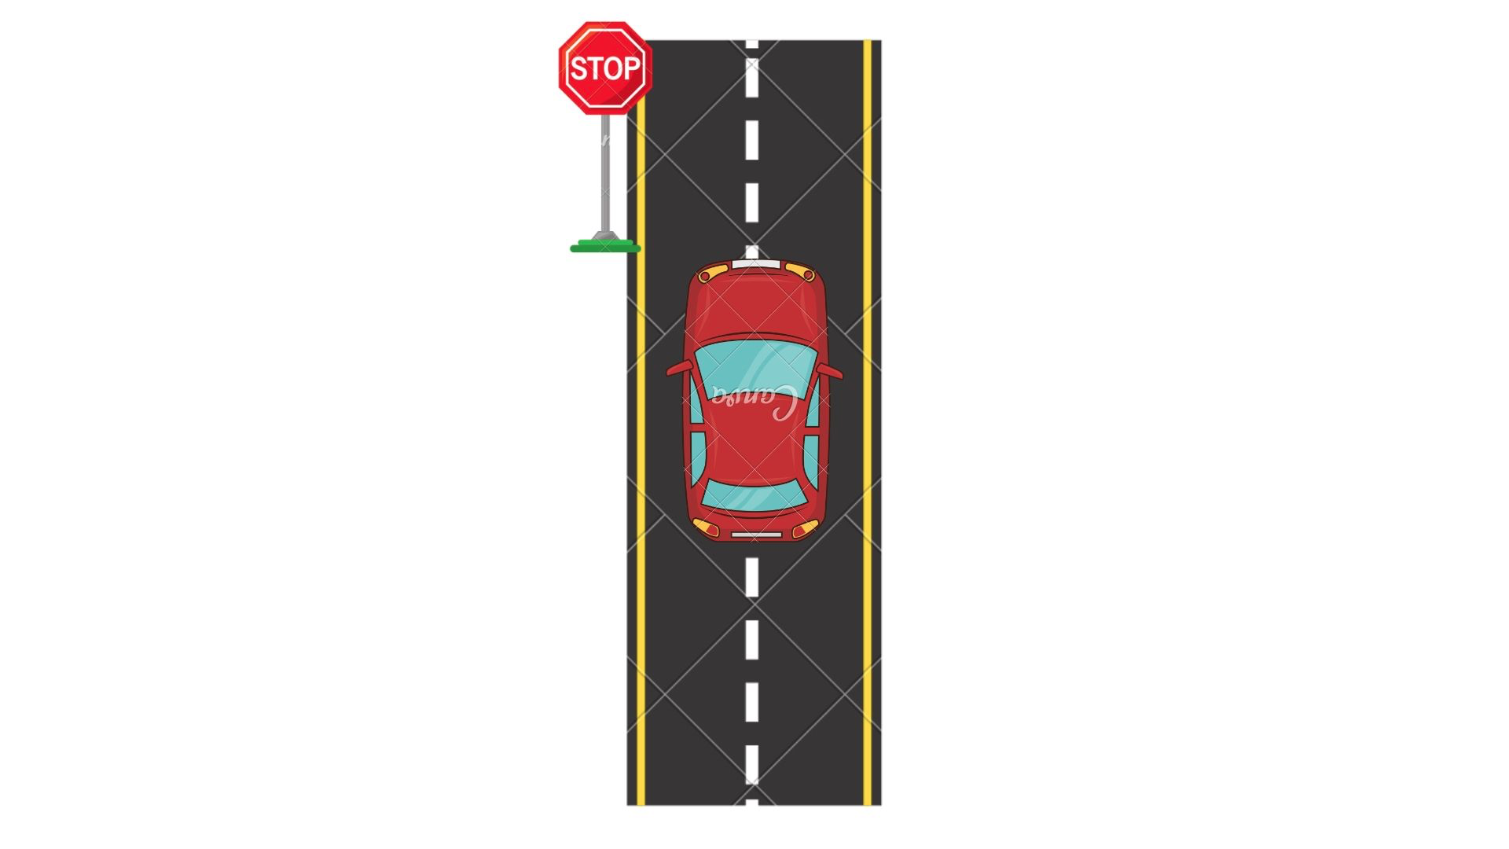
Stop Sign

Slide 5
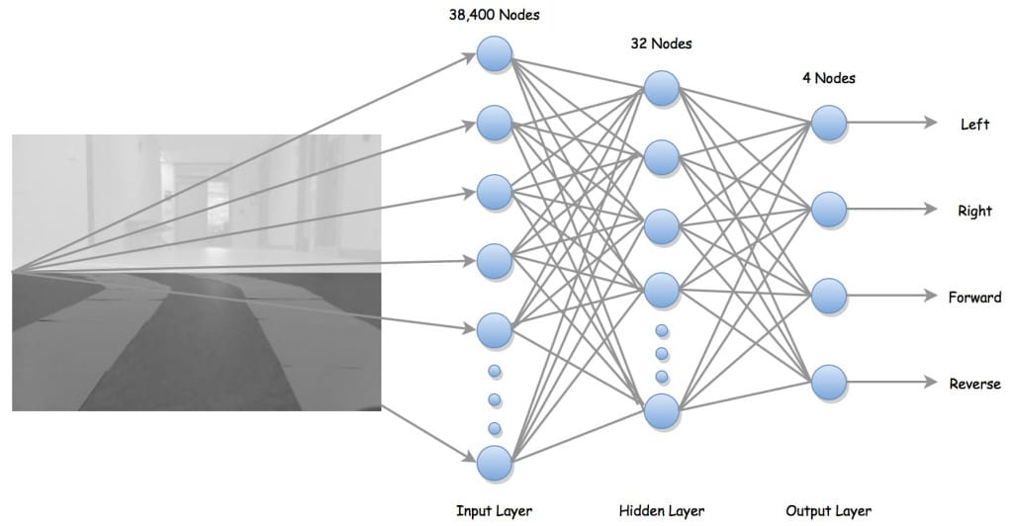
Input Nodes to Output

Slide 6
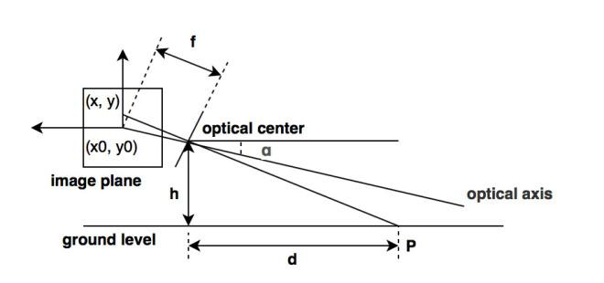
Monocular Vision

Slide 7
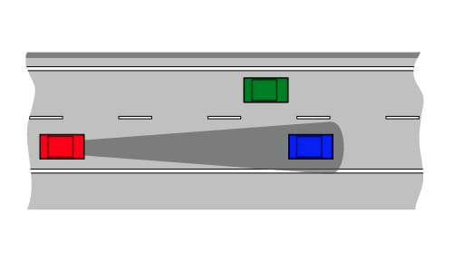
Object Detection

Slide 8
References
[1]Chu Jiangwei, Ji Lisheng, Guo Lie Libibing, Wang Rongben, “Study on Method of Detecting Preceding Vehicle Based on Monocular Camera” in IEEE Intelligent Vehicles Symposium, 2004

